Slide 1


Agile Presentation
Agile at ChadaTech

Slide 2
Various roles within Scrum-Agile
Product Owner (PO)
Scrum Master (SM)
Development Team (DT)
This is the Project Manager of Agile, it is not a traditional approach to management though. More freedom is given to the team. They are responsible for:
Expressing the Product Backlog (work to be done) clearly;
Ordering the items in the Backlog to achieve goals and missions;
Optimizing the value of work the DT performs;
Ensuring transparency of the Backlog to everyone and next work to be done;
Ensuring the DT understands the items in the Backlog.
(Cobb, 2015, Chapter 3)
This is a servant leader role with many responsibilities, but they are on the DT. These responsibilities help the PO:
Effectively manage the Backlog;
Help the Scrum Team understand the need for a clear and concise Backlog;
Understanding product planning in an empirical environment;
And more. They help the DT by:
Coaching the DT in self-organization and cross-functionality;
Helping the DT create high-value products;
Remove impediments to the DT’s progress;
Facilitate Scrum events
Coaching the DT in environments which scrum is not fully adopted or understood.
They serve the organization by:
Leading and coaching the organization in Scrum adoption;
Plan Scrum implementation;
Help all understand and enact Scrum and empirical Product development;
and more.
(Cobb, 2015, Chapter 3)
This consists of Testers and Developers that help ensure the product is “done” according to the specifications. They manage their own work.
They are self-organizing. No one tells them how to turn the Backlog items into increments of potentially releasable functions;
They are cross-functional with all skills necessary to create a product increment;
Scrum recognizes no title other than Developer with no exceptions;
Scrum recognizes no sub-team within the DT again no exceptions;
Accountability is across the entire DT, even if some have specialized skills.
(Cobb, 2015, Chapter 3)

Slide 3
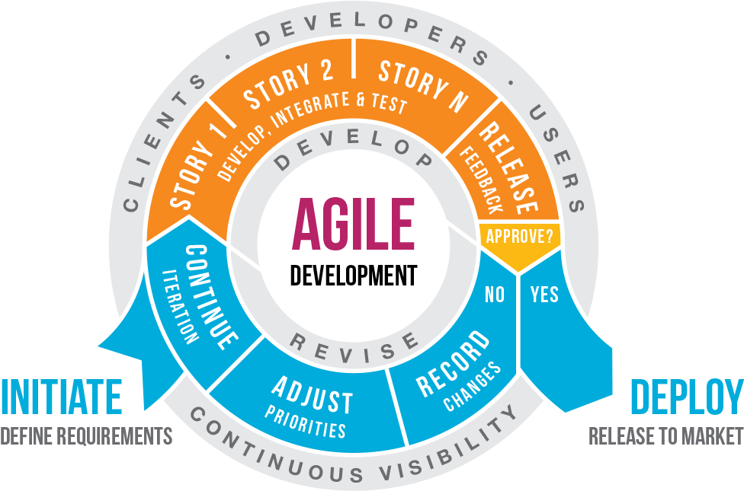
The Software Development Lifecycle In Scrum-Agile
Image courtesy of pngfind.com

Slide 4
The SDLC in scrum-agile
Using our image, we will break down the SDLC. It starts with a project. What requirements are known will be discussed, but many times the requirements will be figured out as the project is developed. Once the PO meets with all the parties involved, they will build a product backlog and then meet with the SM and DT. The PO will have created “user stories” that are short stories of what a user would expect. The topmost stories are selected due to being the most important for the Sprint. A sprint is typically 1-4 weeks with 2 weeks being the most popular currently. The development team will work on those specific stories until they meet what was decided as “done” is. Testing and integration are done concurrent to development so when a product is in the release or feedback stage, testing will have already been completed and the product will work. Daily Scrums are where the team meets for 15 minutes a day and talks about issues they face and problems they overcame. These are done daily during every sprint. If the PO approved the work, it is released. If not, then the required changes are recorded and adjustments to the priority list are made. The sprint team will have a review with the Stakeholders and executives present. Then the SM will have a retrospective with just the DT and PO if available. These last items are so the team can make any adjustments for the next sprint and gather any issues they faced. Did the team not have clear instructions? Was there sickness that caused a delay? Was there an issue with management? Whatever the case it is discussed so the impediment will be removed.
(Cobb, 2015, Chapter 4-5)
Image courtesy of pngfind.com

Slide 5
If waterfall was used in SNHU travel
The common methodology we use is called Waterfall as it cascades down from the top. If we tried to use this methodology and not Agile in the SNHU travel project, we would have ended up failing to meet client requirements and satisfaction. Midway through the project the client decided to shift from just having top rated destinations in a carrousel at the top, to now focusing it on the next big vacation item according to a new study. This next big item was health and wellness travels. If we used the Waterfall method, we would not have had the freedom to shift our resources and still complete the website. We would not have been able to shift so quickly. Also, clear communication from the end-users would have been difficult if not entirely skipped. This allows us to make sure we are adding value for the user in every line of code we right, thus preventing waste. With waterfall we would not have had open communication and the freedom or ability to shift as we did. Likely we would have had to do another “death march” just to complete the project in the timeframe the client requested, causing loss of morale in the team.
(Cobb, 2015, Chapter 1, 18)

Slide 6
Factors to consider in choosing Waterfall or Agile
There are many things to consider in picking Waterfall or Agile methodologies. Not every project should be Agile. If all the constraints and information is clearly understood and little possibility to change is present, then a Waterfall approach can be very successful. However, in many software engineering cases, the design constraints are not known and will not be known until much further into the project. Waterfall is not adaptable in these cases. It takes too much design work to be done before a change is passed down and then a possible overhaul will be needed. Waterfall does not allow the testing to be concurrent thus causing a bottle neck that creates divisions among the teams. Waterfall is still very popular due to the control it gives management. However, lately Agile is taking more of a front running role and companies are seeing great results. It boils down to how much is known and how much will be known as the project progresses. In most cases, Agile will be the best way to go for all parties involved. A hybrid style is possible but only with a very deep understanding of both Agile and Waterfall methodologies. Integration of the two is possible, but fully implementing Agile will bring the largest rewards in the long run on most projects.
(Cobb, 2015, Chapter 1, 18-21)

Slide 7
References:
Cobb, C. G. (2015). The project manager's guide to mastering agile: Principles and practices for an adaptive approach. John Wiley & Sons, Inc. Accessed 2/15/2023

